Slide 1
Chapter 11: File-System Interface

Slide 2
Chapter 11: File-System Interface
File Concept
Access Methods
Disk and Directory Structure
File-System Mounting
File Sharing
Protection

Slide 3
Objectives
To explain the function of file systems
To describe the interfaces to file systems
To discuss file-system design tradeoffs, including access methods, file sharing, file locking, and directory structures
To explore file-system protection

Slide 4
File Concept
Contiguous logical address space
Types:
Data
numeric
character
binary
Program
Contents defined by file’s creator
Many types
Consider text file, source file, executable file

Slide 5
File Attributes
Name – only information kept in human-readable form
Identifier – unique tag (number) identifies file within file system
Type – needed for systems that support different types
Location – pointer to file location on device
Size – current file size
Protection – controls who can do reading, writing, executing
Time, date, and user identification – data for protection, security, and usage monitoring
Information about files are kept in the directory structure, which is maintained on the disk
Many variations, including extended file attributes such as file checksum
Information kept in the directory structure

Slide 6
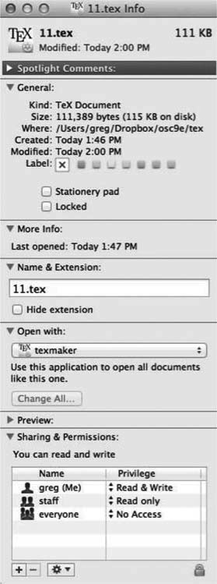
File info Window on Mac OS X

Slide 7
File Operations
File is an abstract data type
Create
Write – at write pointer location
Read – at read pointer location
Reposition within file - seek
Delete
Truncate
Open(F_{i}) – search the directory structure on disk for entry F_{i}, and move the content of entry to memory
Close (F_{i}) – move the content of entry F_{i} in memory to directory structure on disk

Slide 8
Open Files
Several pieces of data are needed to manage open files:
Open-file table: tracks open files
File pointer: pointer to last read/write location, per process that has the file open
File-open count: counter of number of times a file is open – to allow removal of data from open-file table when last processes closes it
Disk location of the file: cache of data access information
Access rights: per-process access mode information

Slide 9
Open File Locking
Provided by some operating systems and file systems
Similar to reader-writer locks
Shared lock similar to reader lock – several processes can acquire concurrently
Exclusive lock similar to writer lock
Mediates access to a file
Mandatory or advisory:
Mandatory – access is denied depending on locks held and requested
Advisory – processes can find status of locks and decide what to do

Slide 10
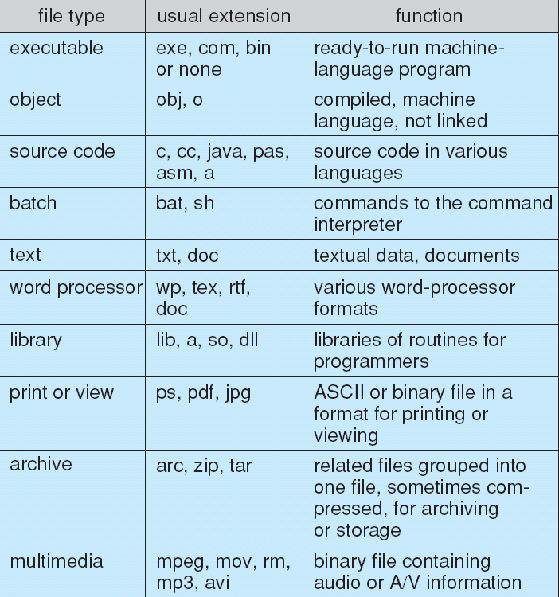
File Types – Name, Extension

Slide 11
File Structure
None - sequence of words, bytes
Simple record structure
Lines
Fixed length
Variable length
Complex Structures
Formatted document
Relocatable load file
Can simulate last two with first method by inserting appropriate control characters
Who decides:
Operating system
Program

Slide 12
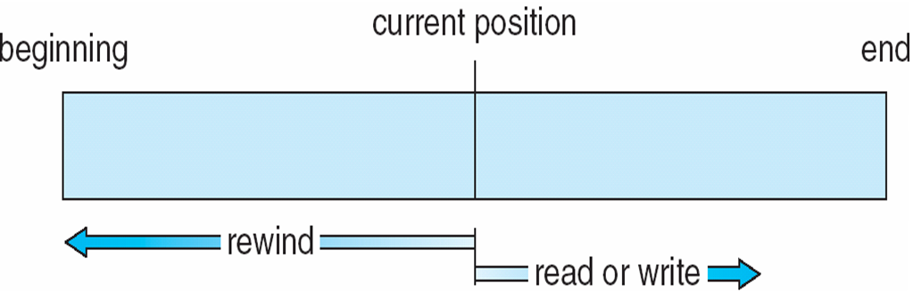
Sequential-access File

Slide 13
Access Methods
Sequential Access
read next
write next
reset
no read after last write
(rewrite)
Direct Access – file is fixed length logical records
read n
write n
position to n
read next
write next
rewrite n
n = relative block number
Relative block numbers allow OS to decide where file should be placed
See allocation problem in Ch 12

Slide 14
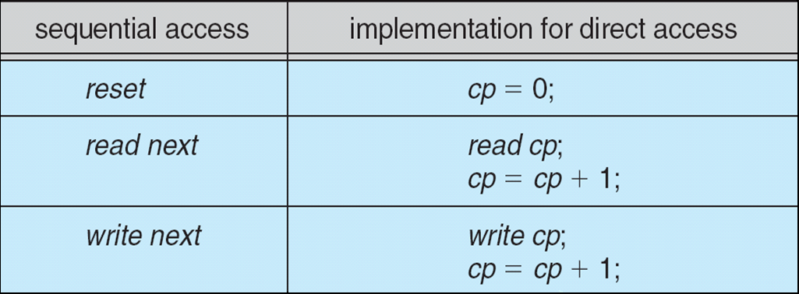
Simulation of Sequential Access on Direct-access File

Slide 15
Other Access Methods
Can be built on top of base methods
General involve creation of an index for the file
Keep index in memory for fast determination of location of data to be operated on (consider UPC code plus record of data about that item)
If too large, index (in memory) of the index (on disk)
IBM indexed sequential-access method (ISAM)
Small master index, points to disk blocks of secondary index
File kept sorted on a defined key
All done by the OS
VMS operating system provides index and relative files as another example (see next slide)

Slide 16
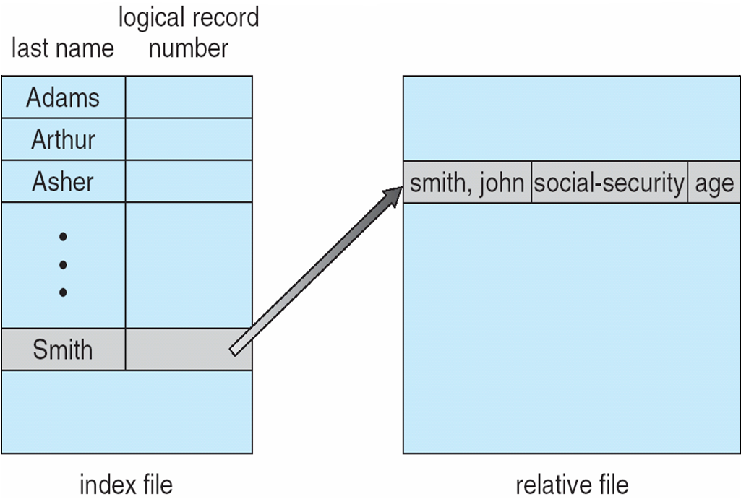
Example of Index and Relative Files

Slide 17
Types of File Systems
We mostly talk of general-purpose file systems
But systems frequently have may file systems, some general- and some special- purpose
Consider Solaris has
tmpfs – memory-based volatile FS for fast, temporary I/O
objfs – interface into kernel memory to get kernel symbols for debugging
ctfs – contract file system for managing daemons
lofs – loopback file system allows one FS to be accessed in place of another
procfs – kernel interface to process structures
ufs, zfs – general purpose file systems

Slide 18
Operations Performed on Directory
Search for a file
Create a file
Delete a file
List a directory
Rename a file
Traverse the file system

Slide 19
End of Chapter 11

